Slide 1

Sprint 1 (Group 8)
TEAM MEMBERS
Rupali A. Thorat
Shrishti A. Mishra
Supriya Kanamarlapudi
Sonali R. Pawar
Suma Garshakurthi
Snehal Yadav

Slide 2

Contents
About the Project
Role of testers in each Module
Process of Testing
Epics and User Stories
Test Scenarios
Requirements
Test Cases
Defect Reporting
Challenges faced and overcome

Slide 3

About the Project
Online shopping is a form of electronic commerce which allows consumers to directly buy goods or services from a seller over the Internet using a web browser or a mobile app.
The main Modules Tested by Online Shopping Websites system are
Verify Registration Functionality
Verify Login Functionality
Verify Search Functionality
Verify Buy Item Functionality
Verify Confirm Booking Functionality

Slide 4

Role of testers in each module
MODULE
Navigation Functionality
Register Functionality
Login Functionality
Search an Item Functionality
Buy an Item Functionality
Confirm Booking Functionality
TESTER
All
Suma
Snehal
Shristi Mishra & Supriya
Sonali Pawar
Rupali Thorat
03-07-2022

Slide 5
Process of Testing
Writing Epics and User Stories
Writing Test Scenarios
Writing Test cases and Requirements
Executing Test cases in Jira Softwares
Writing Defect Reporting
Writing Traceability Matrix

Slide 6
High Level Epics And User Stories
Epic :
An epic is a large chunk of work that you cannot deliver during one sprint.
Instead you can break it down into smaller, more specific units called User stories.
User Stories:
User stories are the smallest units of work in an agile framework.
Several similar user stories makeup an epic.

Slide 7
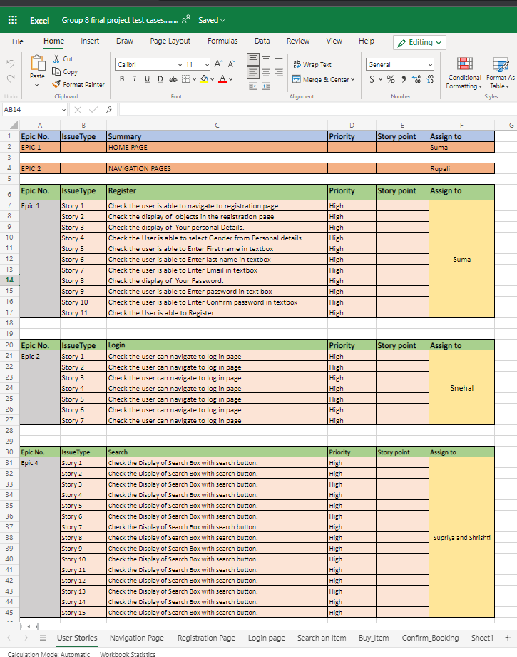
Functionalities
These are the Some of Epics and User stories taken in this Demo web Shop website

Slide 8
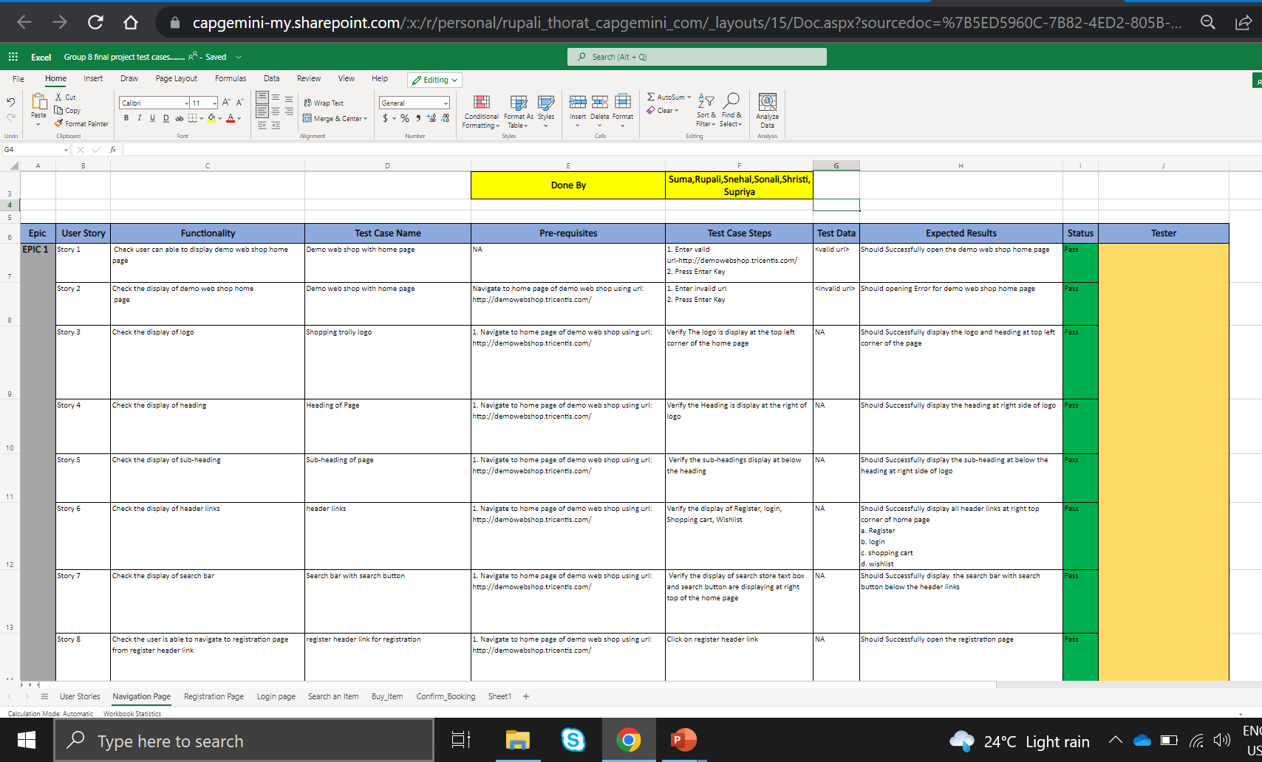
Test Cases

Slide 9
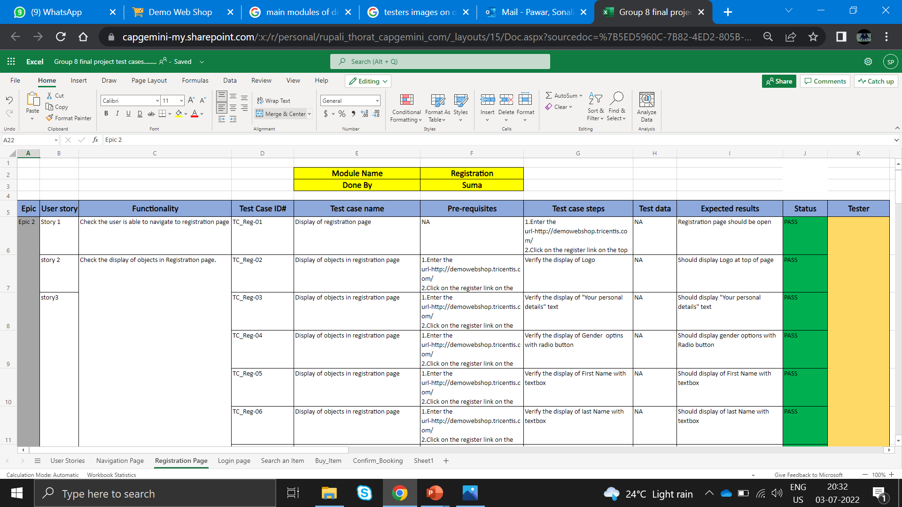
Registration Page

Slide 10
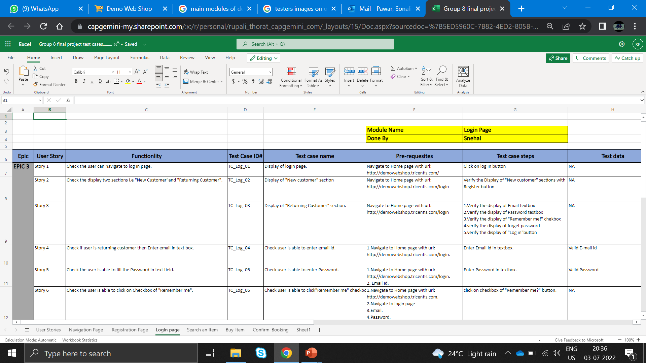
Login Page
03-07-2022

Slide 11
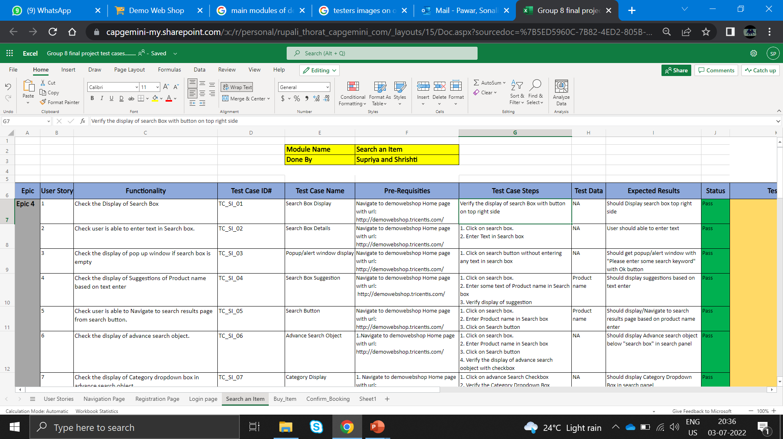
Search Items Page

Slide 12
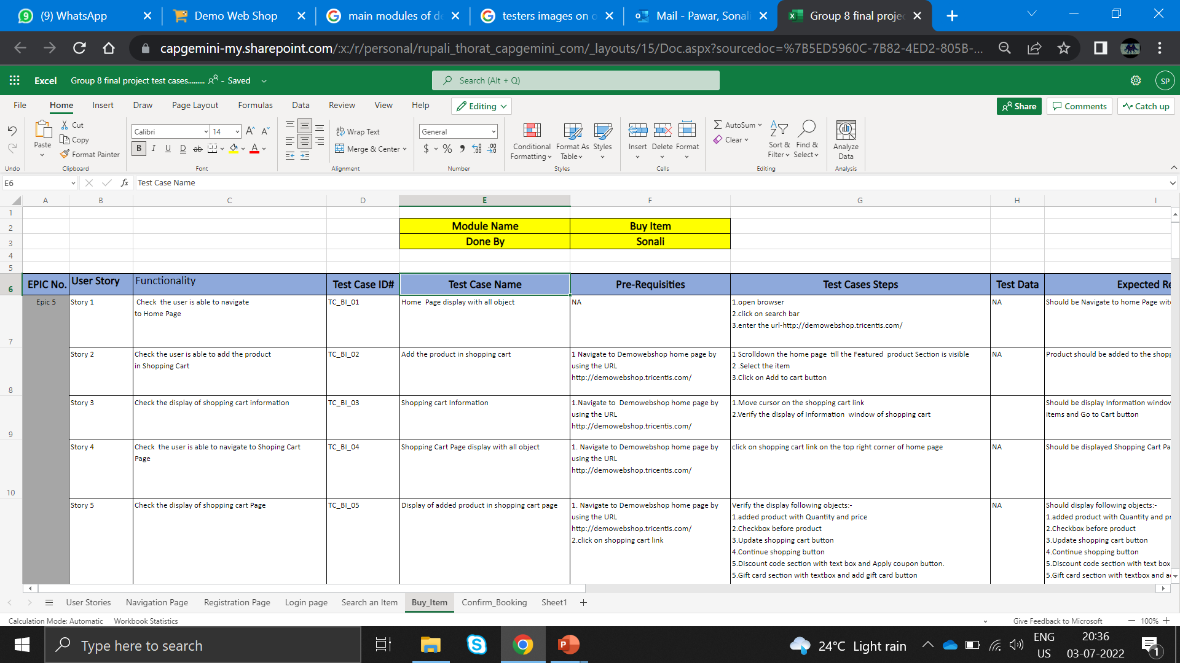
Buy Items Page

Slide 13
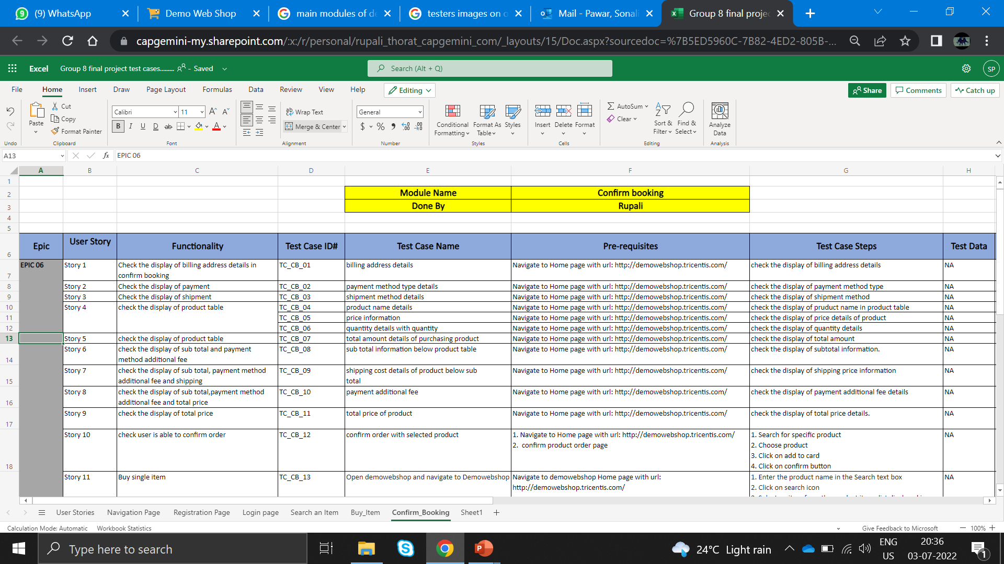
Confirm Booking Page

Slide 14
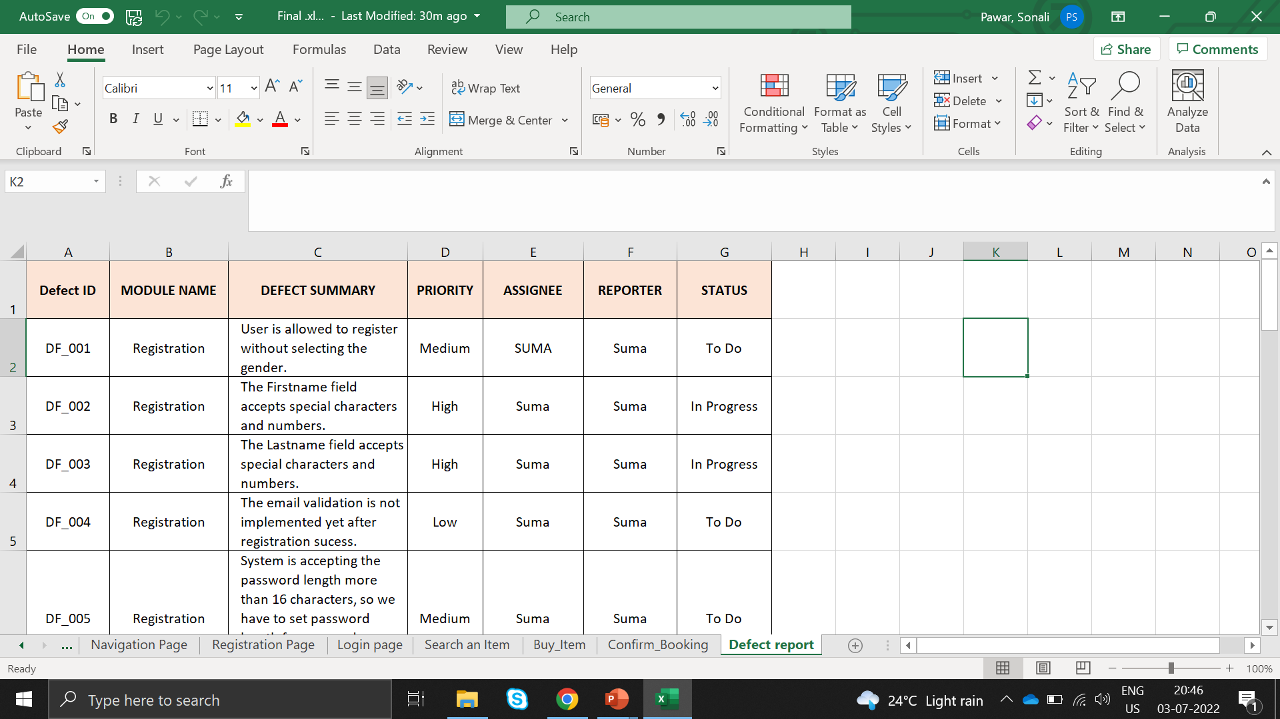
Defect Report

Slide 15
Challenges Faced
In Demo web shop project we faced issues like some times website are not worked when we launch.
As this is Functional testing we does not faced more issue and live application has some of errors in rare case.
How Did We Overcome
We overcome this issues using functional testing and check whether there is any issues in Demo web shop website.

Slide 16
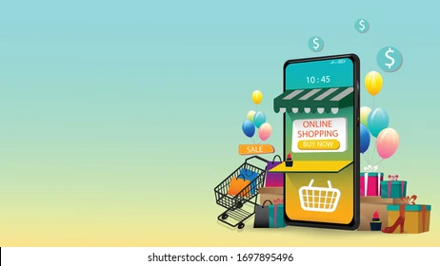
Thank You

